Slide 1
Rearranging formulas
www.kent.ac.uk/student-learning-advisory-service

Slide 2
Rearranging formulas
Introduction
Rules for rearranging simple formulas
All students

Slide 3
Rearranging formulas
Definitions:
Formula – a rule or fact showing the relationship between two or more variables
Rearranging (or transposing) a formula to make a different variable the subject of the formula
Subject – the term on its own on one side of the equal sign. e.g.:
$$°F=°C×\frac{9}{5}+32$$

Slide 4
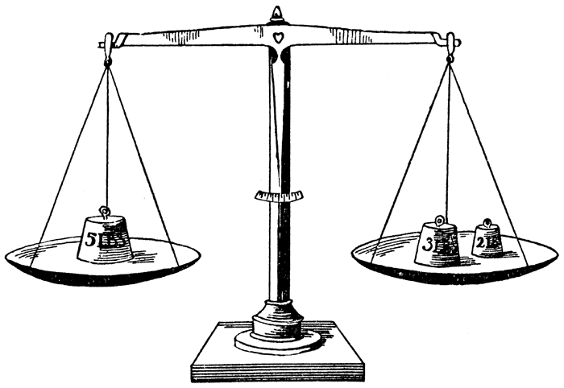
Rearranging formulas
Principles:
The quantity on the left is equal to the quantity on the right
Therefore, to maintain balance, whatever is done to one side to must also be done to the other

Slide 5

Rearranging formulas
Rearrange the below for °C :
$$°F=°C×\frac{9}{5}+32$$
$$°F−32=°C×\frac{9}{5}$$
$$\left(°F−32\right)÷\frac{9}{5}=°C$$
$$°C= \frac{5}{9}(°F−32)$$
① subtract 32 from both sides
② divide both sides by ⁹/₅
③ reverse and simplify
✓

Slide 6


Rearranging formulas
Rearrange the below for c :
$$\sqrt{\frac{E}{m}}=c$$
$$\frac{E}{m}=c^{2}$$
$$E={mc}^{2}$$
① divide both sides by m
② square root both sides

Slide 7

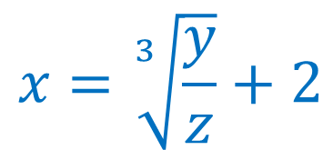
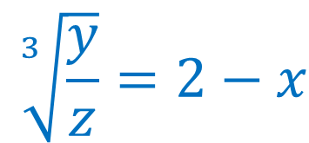
Rearranging formulas
Rearrange the below for x :
$$y=z{\left(2−x\right)}^{3}$$
$$\frac{y}{z}={\left(2−x\right)}^{3}$$
$$\sqrt[3]{\frac{y}{z}}=2−x$$
$$x=\sqrt[3]{\frac{y}{z}}+2$$
✓

Slide 8

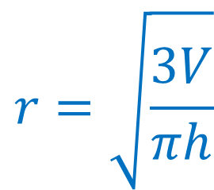
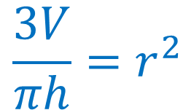
Rearranging formulas
Rearrange the below for r :
$$V=πr^{2}\frac{h}{3}$$
$$3V=πr^{2}h$$
$$r=\sqrt{\frac{3V}{πh}}$$
$$\frac{3V}{πh}=r^{2}$$
✓

Slide 9

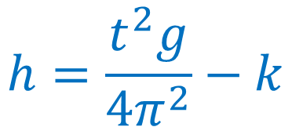
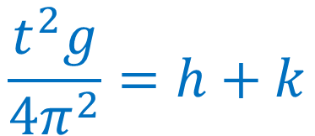
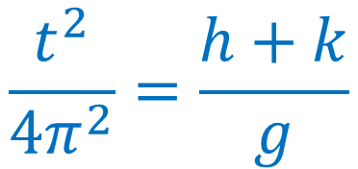
Rearranging formulas
Rearrange the below for h :
$$t=2π\sqrt{\frac{h+k}{g}}$$
$$t^{2}={\left(2π\right)}^{2} \frac{h+k}{g}$$
$$\frac{t^{2}}{4π^{2}}=\frac{h+k}{g}$$
$$\frac{t^{2}g}{4π^{2}}=h+k$$
$$h=\frac{t^{2}g}{4π^{2}}−k$$
✓

Slide 10
Rearranging formulas
Conclusion
Rules for rearranging simple formulas

Slide 11
To book a maths/stats appointment…
www.kent.ac.uk/student-learning-advisory-service

Slide 12
Questions?

