Slide 1


Getting to know SPSS and entering data
www.kent.ac.uk/student-learning-advisory-service
Notes:
No previous experience with SPSS is required.

Slide 2
Learning Outcomes
The aim of this workshop is to get you up and running with SPSS. By the end of this workshop you should know:
How to define variables in SPSS
  Naming variables
  Types of variables
  Specifying decimals
  Types of measurement
How to enter data under each variable

Slide 3

Follow along…
If you haven’t done so already, you will need to install SPSS: https://www.kent.ac.uk/software/spss-statistics

Slide 4
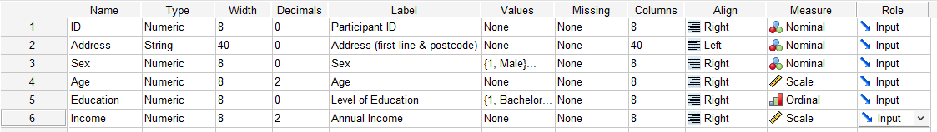
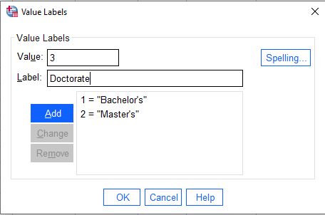

Defining Variables
Variable Name:
Keep as short as possible.
Must follow SPSS naming conventions…
No spaces
No special characters/symbols
First character cannot be a number
Must be unique within the dataset.
Measure:
Scale – continuous data measured at interval or ratio level. Measure quantity. E.g., age, distance, height.
Ordinal – rankings or ordered values. E.g., level of education.
Nominal – categorical data.

Slide 5

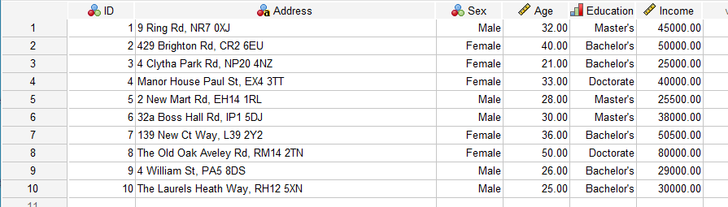

Entering Data

Slide 6



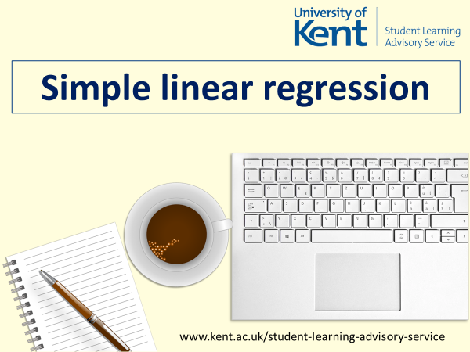
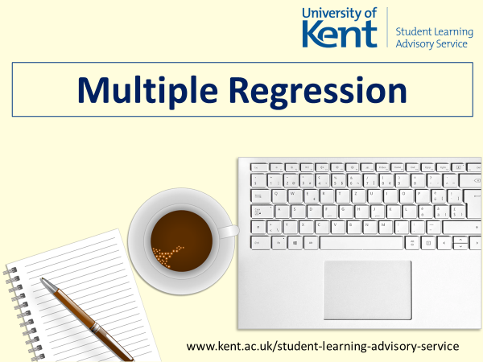
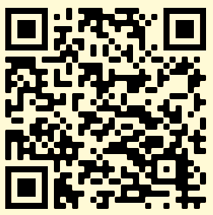
Now the data is ready to be analysed…
www.kent.ac.uk/student-learning-advisory-service

