Slide 1


Correlation
www.kent.ac.uk/student-learning-advisory-service

Slide 2
Correlation
We will introduce Pearson correlation, in particular we will:
  What correlation is
  When we can use Pearson correlation
  Pearson correlation in SPSS
This presentation is intended for students in initial stages of Statistics. No previous knowledge is required.

Slide 3
Correlation
Describes an association between variables.
When one variable changes, so does the other.
Covariation, rather than a direct causal link.
Examples:
Ice cream sales and shark attacks
Time spent in shops and temperature

Slide 4
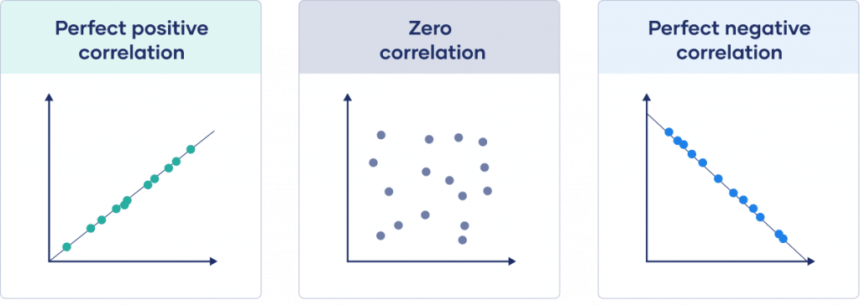
Pearson Correlation
The Pearson correlation coefficient (r) measures the strength and direction of the relationship between variables.
r = 1
r = 0
r = -1
Same direction
Opposite direction
https://www.scribbr.com/statistics/correlation-coefficient/

Slide 5
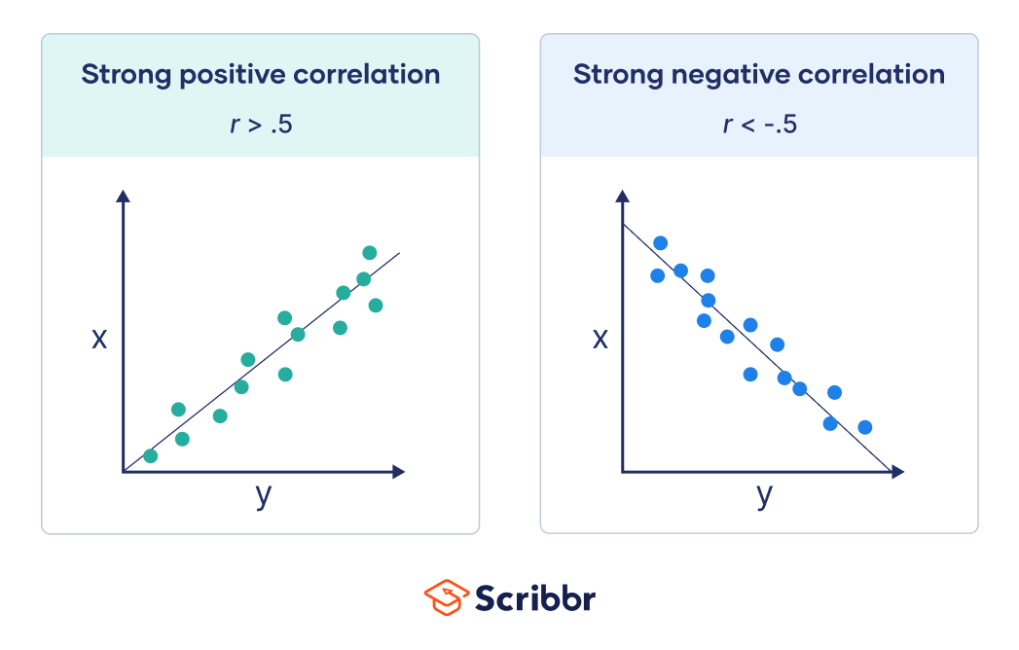
Pearson Correlation
Strong relationship: r is greater than .5
https://www.scribbr.com/statistics/correlation-coefficient/

Slide 6
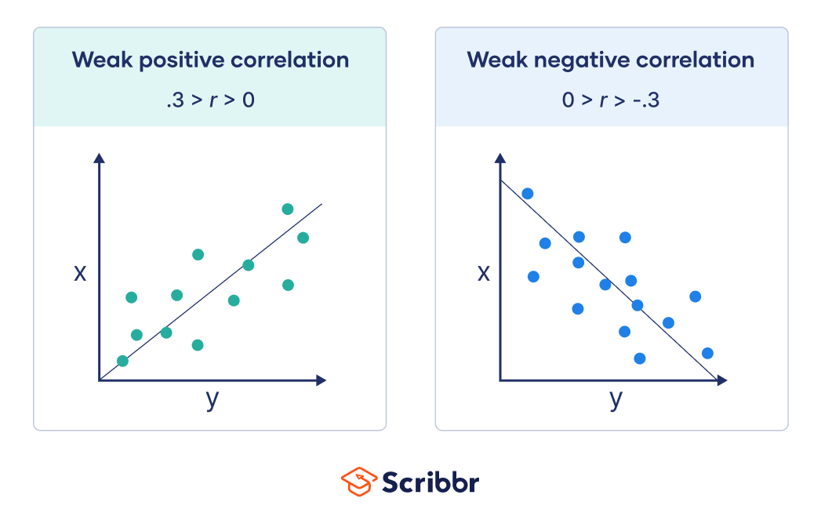
Pearson Correlation
Weak relationship: r is between 0 and .3
https://www.scribbr.com/statistics/correlation-coefficient/

Slide 7
Assumptions
Variables must be measured at interval or ratio level (continuous).
Related pairs:
  Each subject/observation must provide a score on variable X and Y. In other words, both pieces of information are from the same subject.
Independence of observations:
  The observations that make up your data must be independent of one another.
Normal Distribution
Pallant, J. (2010). SPSS survival manual

Slide 8
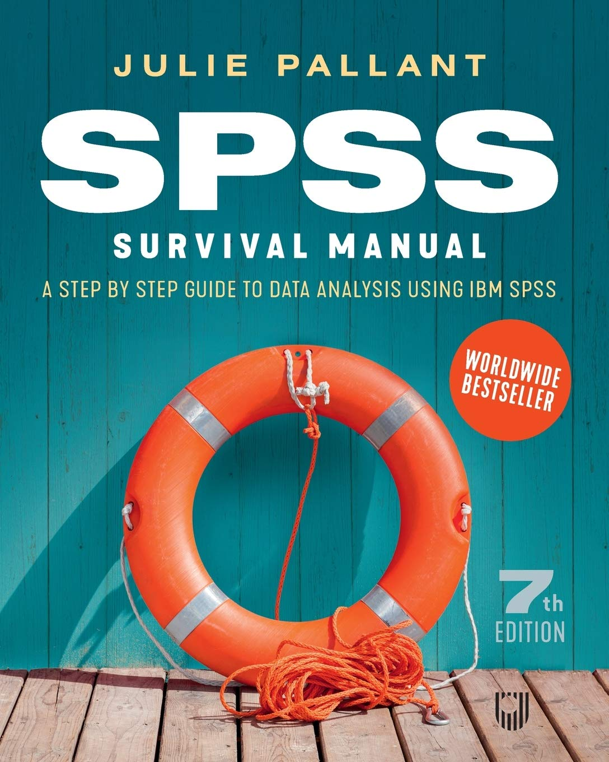
Correlation in SPSS
Go to: www.openup.co.uk/spss
Click the link to access the support website
Under ‘Data Files & Exercises’ click ‘Data Files’
Download the survey.zip file
Then follow along!
To do this, you will need to install SPSS: https://www.kent.ac.uk/software/spss-statistics

Slide 9


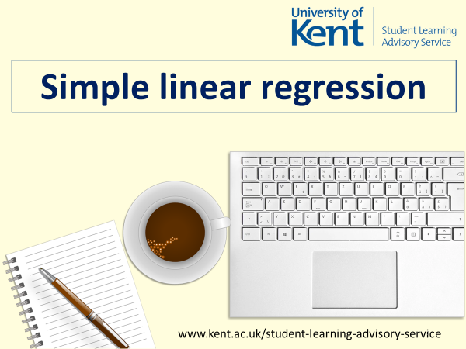
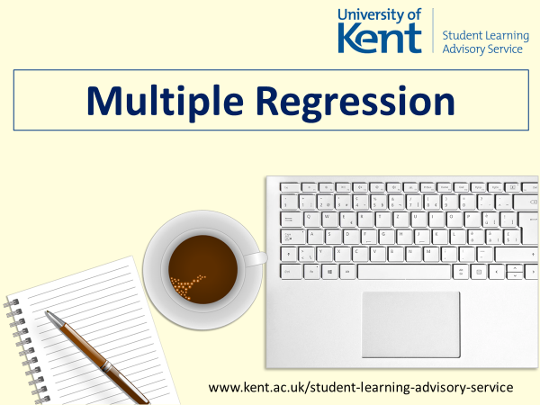

Upcoming workshops…
www.kent.ac.uk/student-learning-advisory-service
maths/stats appointments available!

