Slide 1
Chi-square Test
www.kent.ac.uk/student-learning-advisory-service

Slide 2
Chi-square Test
We will introduce chi square test, in particular we will cover:
What a chi square test is
Chi square test in SPSS
This presentation is intended for students in initial stages of Statistics. No previous knowledge is required.

Slide 3
Chi-square Test
A non-parametric test that is used to measure the association between two categorical variables.
We use it when we have observed frequencies of a categorial variable (e.g., male vs female, healthy vs sick).

Slide 4
Chi-square Test
There are 2 types of chi-square tests:
The chi-square goodness of fit test is used to compare the observed frequencies in a data sample with the frequencies based on some prior expectation – either empirical or theoretical.
The chi-square test of independence assesses whether observed frequencies are dependent on (i.e., contingent on) certain conditions.

Slide 5
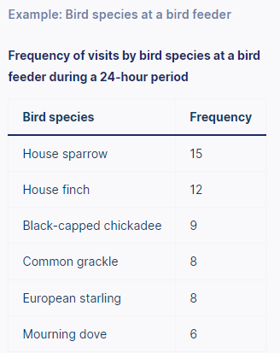
Chi-square frequency tables
A frequency distribution table / contingency table shows how observations are distributed between different groups (i.e., the number of observations in each group).
A chi-square goodness of fit test can test whether these observed frequencies are significantly different from what was expected, such as equal frequencies.
Null hypothesis (H₀): The bird species visit the feeder in the same proportions as the average over the past five years.
Alternative hypothesis (H₁): The bird species visit the feeder in different proportions from the average over the past five years.
https://www.scribbr.com/statistics/chi-square-tests/

Slide 6
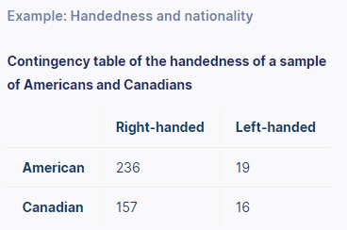
Chi-square frequency tables
A frequency distribution table / contingency table shows how observations are distributed between different groups (i.e., the number of observations in each group).
A chi-square test of independence can test whether these observed frequencies are significantly different from the frequencies expected if handedness is unrelated to nationality.
Null hypothesis (H₀): The proportion of people who are left-handed is the same for Americans and Canadians.
Alternative hypothesis (H₁): The proportion of people who are left-handed differs between nationalities.
https://www.scribbr.com/statistics/chi-square-tests/

Slide 7
Assumptions of the Chi-square
Since we only require that the two variables are categorical, there are no assumptions required on the variables in the Chi-Square test.

Slide 8
The X² statistic
Both of Pearson’s chi-square tests use the same formula to calculate the chi-square (X²) statistic:
Where:
X² is the chi-square statistic
Σ is the summation operator (i.e., it “takes the sum of”)
O is the observed frequency
E is the expected frequency
The larger the difference between the observations and expectations (O – E in the equation), the bigger the chi-square statistic will be.
The chi-square statistic gets compared with a critical value using a chi-square critical value table or statistical software.
https://www.scribbr.com/statistics/chi-square-tests/

Slide 9
Chi-square test of Independence in SPSS
Go to: http://www.discoveringstatistics.com/docs/ds_data_files/SPSS%20Data%20Files/
Download the Cats.sav file
Then follow along!
To do this, you will need to install SPSS: https://www.kent.ac.uk/software/spss-statistics

Slide 10
Upcoming workshops…
www.kent.ac.uk/student-learning-advisory-service
maths/stats appointments available!

